Slide 1

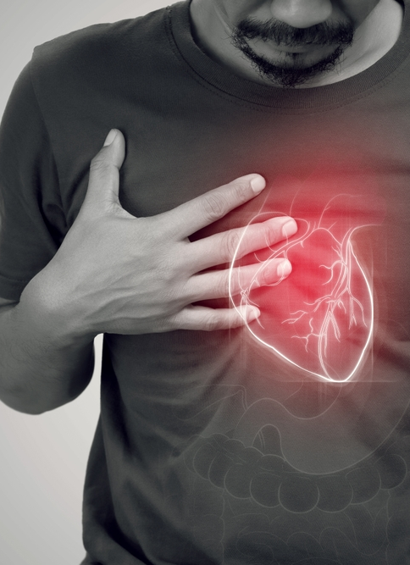




Predictive Modeling: Heart Disease Analysis
BY:
Seyoung Koo, Emory Ellis, Navjit Singh, Desiree Bethelmie
Notes:
*** Change this ***Good [morning/afternoon/evening], everyone! I'm excited to share with you an inspiring journey into the world of proactive healthcare. Imagine a healthcare landscape where staying healthy isn't just about fixing problems but preventing them in the first place. That's precisely what Beaumont Healthcare, our leading institution, is striving to achieve.
At Beaumont, we've embarked on a mission to revolutionize healthcare by curating tailored preventive strategies. How are we doing this? Through the power of data. We're tapping into a rich tapestry of health indicators, demographic specifics, and lifestyle insights – a treasure trove guiding us towards a proactive path of disease prevention.
Picture this data as a roadmap that not only shows us prevalent health statuses but also shines a light on those critical risk factors lurking beneath the surface. We're uncovering how lifestyle choices intertwine with reported health conditions, helping us understand the 'why' behind health outcomes.
So, armed with this profound understanding, we're crafting interventions and strategic healthcare programs designed with you – our vibrant college community – in mind. Our goal is simple: not just to fight chronic ailments like heart disease and diabetes but to equip each of you with the knowledge and resources needed to make informed health decisions.
Imagine a healthcare experience tailored to your unique needs, empowering you to take charge of your well-being. This isn't just a dream; it's our vision of a future where holistic, preventive healthcare becomes the norm, supporting each of you in your journey towards a healthier, happier life.
Thank you for joining us on this transformative healthcare journey. Together, let's embrace this data-driven approach and pave the way for a healthier future – because prevention truly is the best medicine!"

Slide 2
Tables of Contents:
Business Problem
Dataset & Variables used
Data Exploration & Preprocessing phases
Describe results and findings:
Logistic Regression Model
K-Nearest Neighbor Model
Neural Network Model
Summary

Slide 3

Business Problem: Predicting the Likelihood of Heart Disease in a Health Clinic's Patient Population
Beaumont health clinic aims to assess the risk factors associated with heart disease among its patient population. They hired our team to collect data on various health indicators, lifestyle factors, and medical history of their patients. The clinic wants to leverage this data to build a predictive model that can identify individuals at higher risk of developing heart disease. Our model is going to be used to develop interventions that address patient unique, individual need and health concern.
Notes:
Desiree – Since I completed this portion of the project .

Slide 4
Dataset:
Data- found on Kaggle, includes patient information such as age, gender, BMI, general health assessment, smoking history, alcohol consumption, exercise routine, diabetes status, depression scale, checkup frequency, and various dietary habits.(CVD_Cleaned_data.csv)
(original Sample)
Notes:
Desiree – Since I completed this part of the presentation

Slide 5
Variables Used:
Alcohol_Consumption - the amount of alcohol each patients consumed as a numeric value.
Age_Above_60 – is the patient above or below age 60 ( 1= yes, 0=no) .
General_Health- is the patient in “Good” = 1 “Poor”= 0 health.
Smoking_History- Does the patient smoke( 1=yes,0=no)
Sex- is the patient “Male”=0 or “Female”= 1.
Diabetes- does the patient have Diabetes?
Depression- does the patient have depression?
Exercise- does the patient exercise ?
Heart_Disease- does the patient have heart disease?
Arthritis- does the patient have Arthritis?
Weight_.kg.- patient’s weight in Kilograms.
Fruit_Consumption-the number of fruits a patients consumes over a set time period .
Green_Vegetables_Consumption- the number of green vegetables each patient consumes over a set period.
Notes:
Desiree Bethelmie- I completed this part of the project .

Slide 6
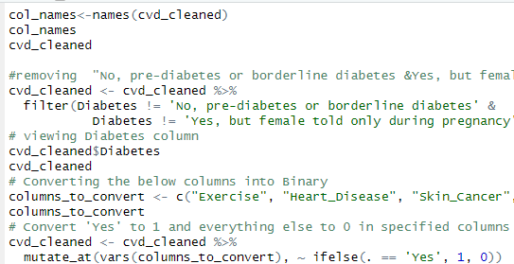
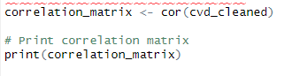

Data Exploration & Preprocessing
Dataset did not contain any missing values or NAs.
Created dummy variables for categorical variables, converting non-numerical categories into a set of binary (0 or 1) variables, allowing statistical models to process categorical data effectively.
Sample size reduced from over 300,000 observations to 2,000 observations.
Data Partition (training 60% & validation 40%).
Correlation matrices were used to assess the strength and direction of relationships between variables in the dataset, aiding in identifying associations, redundancies and influential factors before conducting analysis and modeling .
Data Visualization : Utilized a heatmap as a graphical tool to demonstrate relationships between different variables via color gradients and variable selection.
Notes:
Desiree Bethelmie- I completed this part of the project .

Slide 7
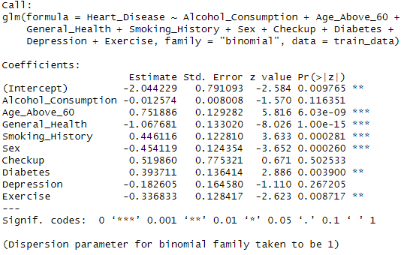
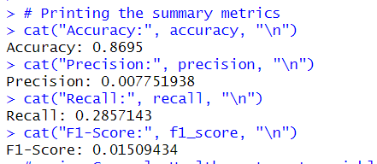
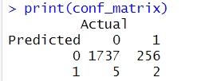
Logistic Regression
Logistic Regression Model: Provides interpretable coefficients that describe the relationship between predictors and the probability of a binary outcome, allowing for straightforward interpretation.
Logistic regression model predicted heart disease based on factors like age above 60, general health, smoking history, sex, diabetes, and exercise.
Age above 60, poor general health, smoking history, male gender, and diabetes were significant predictors of heart disease.
Alcohol consumption, checkup frequency, depression, and exercise showed less or no significant impact on heart disease prediction.
Heart _Disease= -2.044+-0.0126*Alcohol_Consumption+ 0.752*Age_Above -1.068*General Health +
0.446*Smoking History-0.454*Sex+0.520*Checkup+
0.394*Diabetes-0.183*Depression-0.337*Exercise
Notes:
Navjit

Slide 8
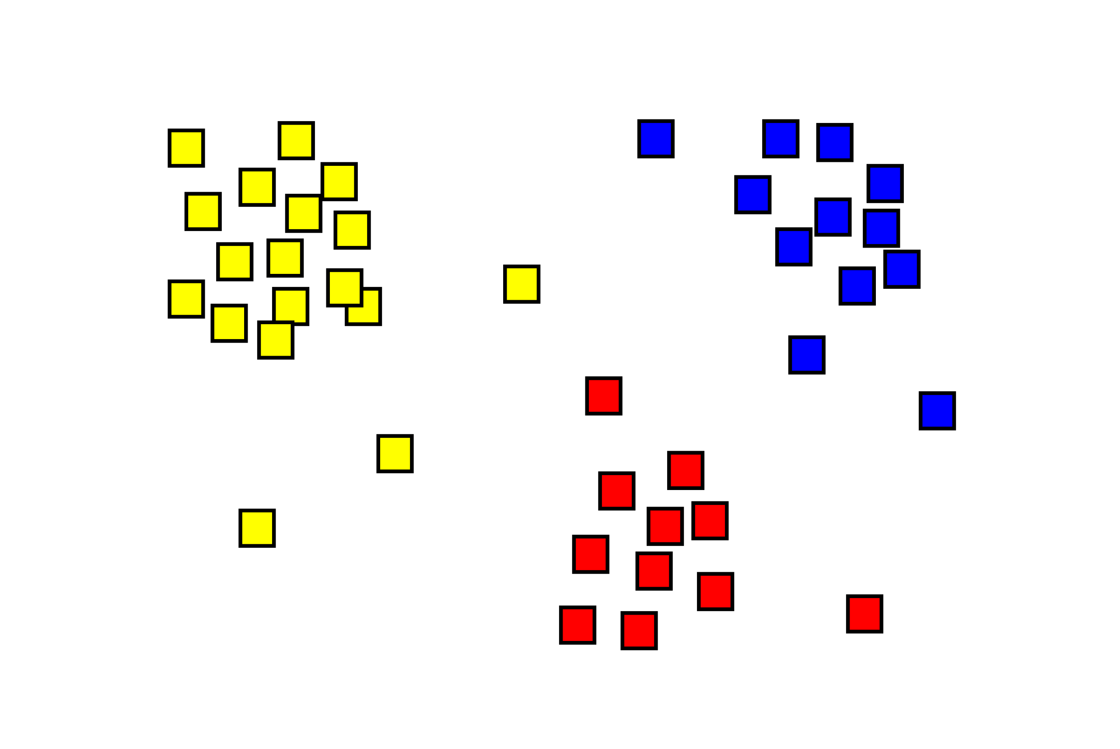
KNN Model
A basic, yet powerful way to use clustering to predict heart disease in future patients based on other attributes
We transformed the data to eliminate any unhelpful attributes as well as changed the values of the attributes whose contents were given to us in an unstructured format so that the model could more easily understand the data
New data points are labeled based on their Euclidean distance to the nearest 'k' number of known data points
Notes:
Emory

Slide 9
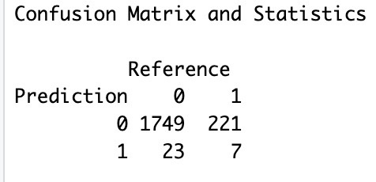
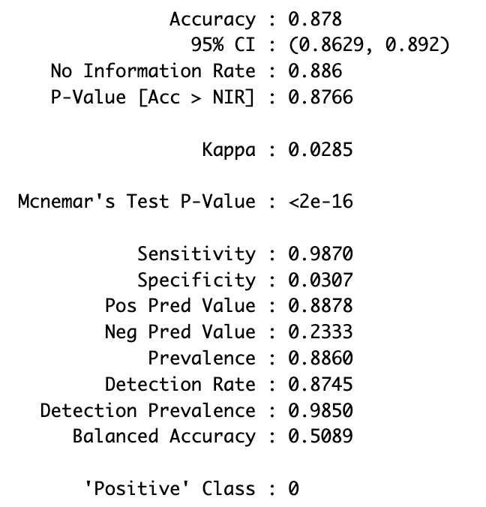
KNN Model
Accuracy Rate: 87.8%
Sensitivity: 98.7%
False Positive Rate: 1.3%
Selecting k=5 showed great results in terms of accuracy, sensitivity and false positive rate
​The false positive rate is the most important statistic, as we don't want to mislabel a patient as being not prone to heart disease, when in fact they are
Notes:
Emory

Slide 10

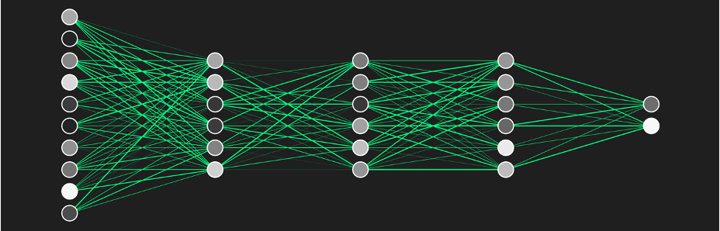

Notes:
Sean

Slide 11
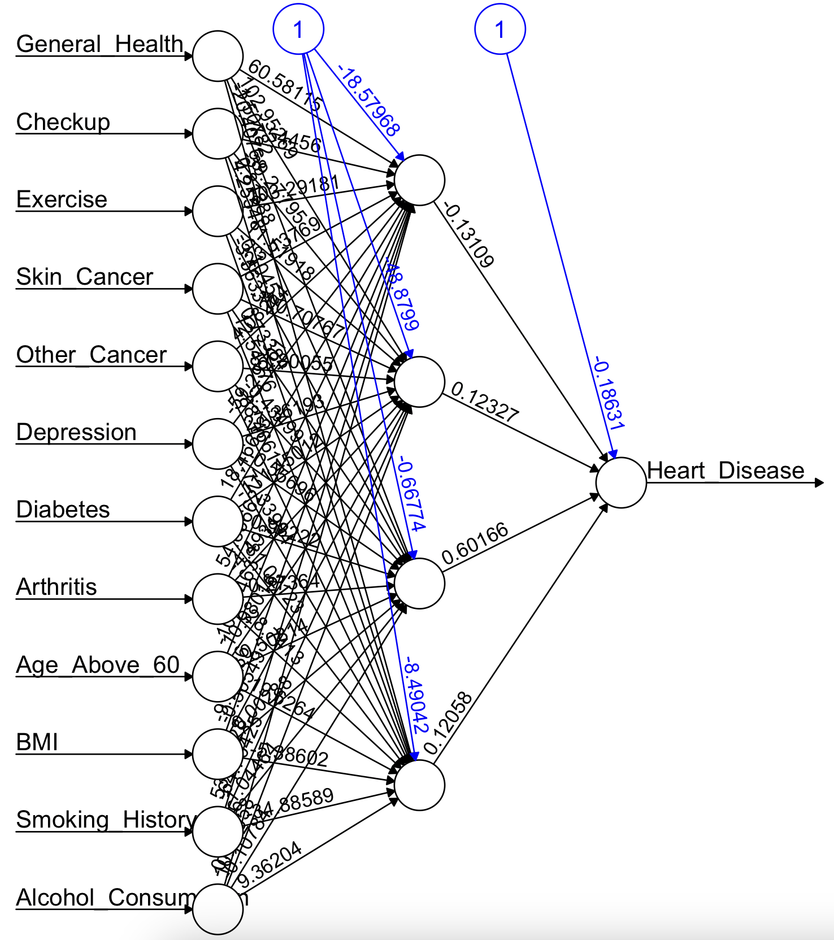
Input Layer: 12 nodes
Hidden Layer: 4 nodes
Output Layer: 1 node
Hidden 1
[1] -0.131 [2] -0.5399 [3]-2.0957 [4]-0.1284 [5]-1.2238
[6] 0.0662 [7]-0.0224 [8] -0.0078 [9]-0.0122 [10]-0.0178 [11] -0.0379 [12]0.0001 [13] 0.0074
Hidden 2
[1] 0.123 [2] -0.5314 [3] -0.4371 [4] -0.0659 [5] -0.2116
[6] 1.2000[7] 0.1583 [8] -0.6297 [9] -0.4371 [10]-0.3184
[11] -0.4632 [12] 1.0199 [13] -1.0221
Hidden 3
[1] 0.602 [2] 0.5145 [3] 0.1683 [4] 0.0645 [5] 0.2045
[6] -1.1867 [7] -0.1544 [8] 0.6198 [9] 0.4328 [10] 0.3128
[11] 0.4606 [12] -1.0109 [13] 1.0139
Hidden 4
[1] 0.12- [2] -0.0585 [3] -0.2475 [4] -0.0132 [5] 3.7115
[6] 0.0067 [7] -0.0023 [8] -0.0007 [9] -0.0012 [10] -0.0019 [11] -0.0038 [12] 0.0000 [13] 0.0007
Output
[1] -1.304874 [2] -0.121198 [3]1.061843
[4] 1.062792 [5] 1.377776
Notes:
Sean

Slide 12
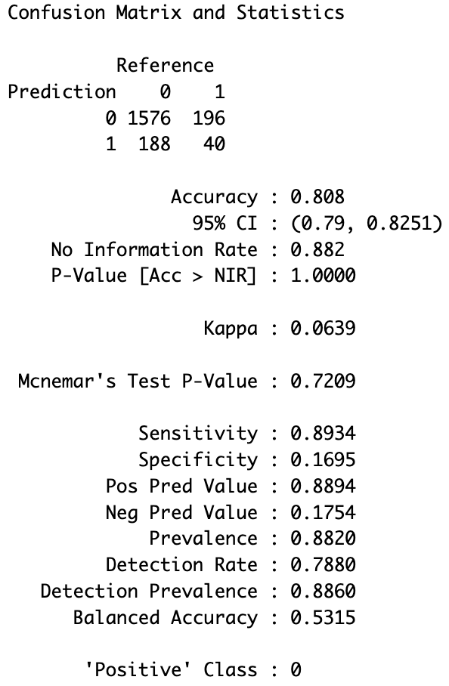
Neural Network
Accuracy Rate: 80.8%
Sensitivity: 89.34%
False Positive Rate: 11%
Good predictive ability
Captured complex relationships
No need to specify a model (truly unsupervised)
No insight into relationships between predictors and outcome
No variable-selection mechanism
Heavy computational requirements
Notes:
Sean

Slide 13
Summary
Recommendation: We are recommending that Beaumont uses the logistic regression model moving forward. While all three models showed a strong accuracy rate, we felt it was important to focus on the false positive rate, as we don't want to mislabel someone not at risk of heart disease when they in fact are. The logistic regression model was the model that showed the lowest false positive rate of our three models.
Additional findings:
Male Patients above the age of 60 who smoke and have poor general health, not only have diabetes but have a high chance of also having heart disease as well than females around the same age.
More Exercise and better dietary habits can significantly reduce the presence of heart disease and diabetes in patients.
From this model, the most significant variables we observed that affect the likelihood of heart disease were: being above the age of 60, being in poor general health, sex, and if the patient is a smoker.
Notes:
ALL

